Slide 1


Face Mask Recognition using deep learning
E.Manideep Reddy
99220041175

Slide 2

INTRODUCTION
The COVID-19 pandemic has reshaped daily life, making face masks a crucial tool in preventing the spread of the virus.
With the increasing use of face masks, there arises a need for automated recognition systems to enhance safety and security.
The project aims to leverage deep learning techniques to develop an accurate and efficient face mask recognition system.

Slide 3
SOFTWARE TOOLS USED
Pandas
Keras
Tensorflow
Matplotlib
Numpy
Spicy
Pycharm

Slide 4
USAGE OF TOOLS
Python is an interpreted, object-oriented, high-level programming language with dynamic semantics
Keras is an API designed for human beings, not machines. Keras follows best practices for reducing cognitive load: it offers consistent & simple APIs.
TensorFlow is an open source framework developed by Google researchers to run machine learning, deep learning and other statistical and predictive analytics workloads
Matplotlib is a comprehensive library for creating static, animated, and interactive visualizations in Python

Slide 5
USAGE OF TOOLS
NumPy (pronounced /ˈnʌmpaɪ/ (NUM-py) or sometimes /ˈnʌmpi/ (NUM-pee)) is a library for the Python programming language.
SciPy provides algorithms for optimization, integration, interpolation, eigenvalue problems, algebraic equations, differential equations, statistics and many other classes of problems
: PyCharm is a dedicated Python Integrated Development Environment (IDE) providing a wide range of essential tools for Python developers

Slide 6
REPORTED LITERATURE
Our project builds upon existing research in face mask recognition, leveraging insights from notable papers such as [cite relevant papers].
Research findings emphasize the effectiveness of deep learning models in image classification tasks, providing a foundation for our work.

Slide 7
OBJECTIVES
Develop a real-time face mask recognition system for accurate identification of individuals wearing or not wearing masks.
Enhance public safety by integrating the system into surveillance and monitoring infrastructure.
Explore potential applications in healthcare, transportation, and various public spaces.

Slide 8
TIME LINE OF WORK PROPOSAL
Phases:
Data Collection(1 WEEK)
Data Preprocessing(2-4 WEEK)
Model Architecture Design(4-6 WEEK)
Model Training and Validation(6-8 WEEK)
Testing and Evaluation(8-10 WEEK)
Integration and Deployment(10-12 WEEK)

Slide 9
USED ALGORITHMS
Convolutional Neural Networks (CNNs):
Chosen for their effectiveness in image classification tasks, especially in the domain of facial recognition.
Transfer Learning:
Leveraging pre-trained models such as VGG16 or ResNet to capitalize on existing knowledge and optimize training efficiency.

Slide 10
WORK DONE IN STEP BY STEP
DESCRIPTION
Step 1: Data Collection
Gathered a diverse dataset comprising images of individuals with and without face masks in various settings.
Step 2: Data Preprocessing
Resized and standardized images, performed data augmentation to enhance dataset diversity.
Step 3: Model Architecture
Designed a custom CNN architecture tailored for face mask recognition, balancing accuracy with computational efficiency.
Step 4: Model Training and Validation
Trained the model on the preprocessed dataset, fine-tuned using transfer learning, and validated performance on a separate test set.

Slide 11
RESULTS AND DISCUSSION
Results:
Demonstrated high accuracy in detecting the presence or absence of face masks.
Confusion Matrices:
Illustrate the model's ability to minimize false positives and negatives.
Discussion:
Address challenges encountered during testing and assess the model's performance in real-world scenarios

Slide 12
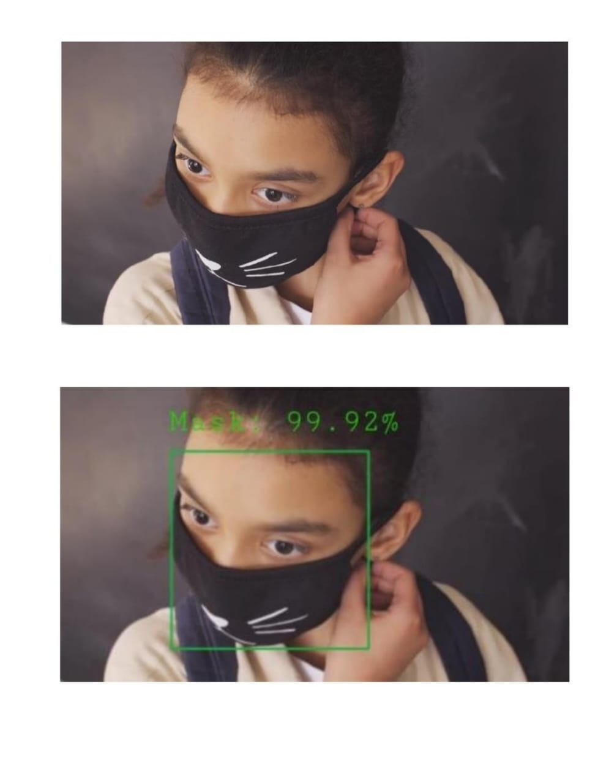
RESULT

Slide 13
SUMMARY
Our project has successfully developed a deep learning-based face mask recognition system with promising accuracy rates.
Challenges faced during the project have provided valuable insights, contributing to ongoing improvements.
The system's potential applications extend beyond the current pandemic, making significant contributions to public safety and health monitoring.

Slide 14
REFERENCES
1.Militante, S. V., & Dionisio, N. V. (2020). Real-Time Face Mask Recognition with Alarm System using Deep Learning. 2020 11th IEEE Control and System Graduate Research Colloquium
(ICSGRC), Shah Alam, Malaysia. https://doi.org/10.1109/ ICSGRC49013.2020.9232610
2. Guillermo, M., Pascua, A. R. A., Billones, R. K., Sybingco, E.,
Fillone, A., & Dadios, E. (2020). COVID19 Risk Assessment
through Multiple Face Mask Detection using MobileNetV2 DNN. The 9th International Symposium on Computational Intelligence and Industrial Applications (ISCIIA2020), Beijing, China. https:// isciia2020.bit.edu.cn/docs/20201114082420135149. Pdf
3. Boyko, N., Basystiuk, O., & Shakhovska,N. (2018). Performance Evaluation and Comparison of Software for Face Recognition,
Based on Dlib and Opencv Library. 2018 IEEE Second
International Conference on Data Stream Mining & Processing
(DSMP), Lviv, Ukraine. https://doi.org/10.1109/DSMP.2018.8478556
4. Cousera

Slide 15
